Slide 1
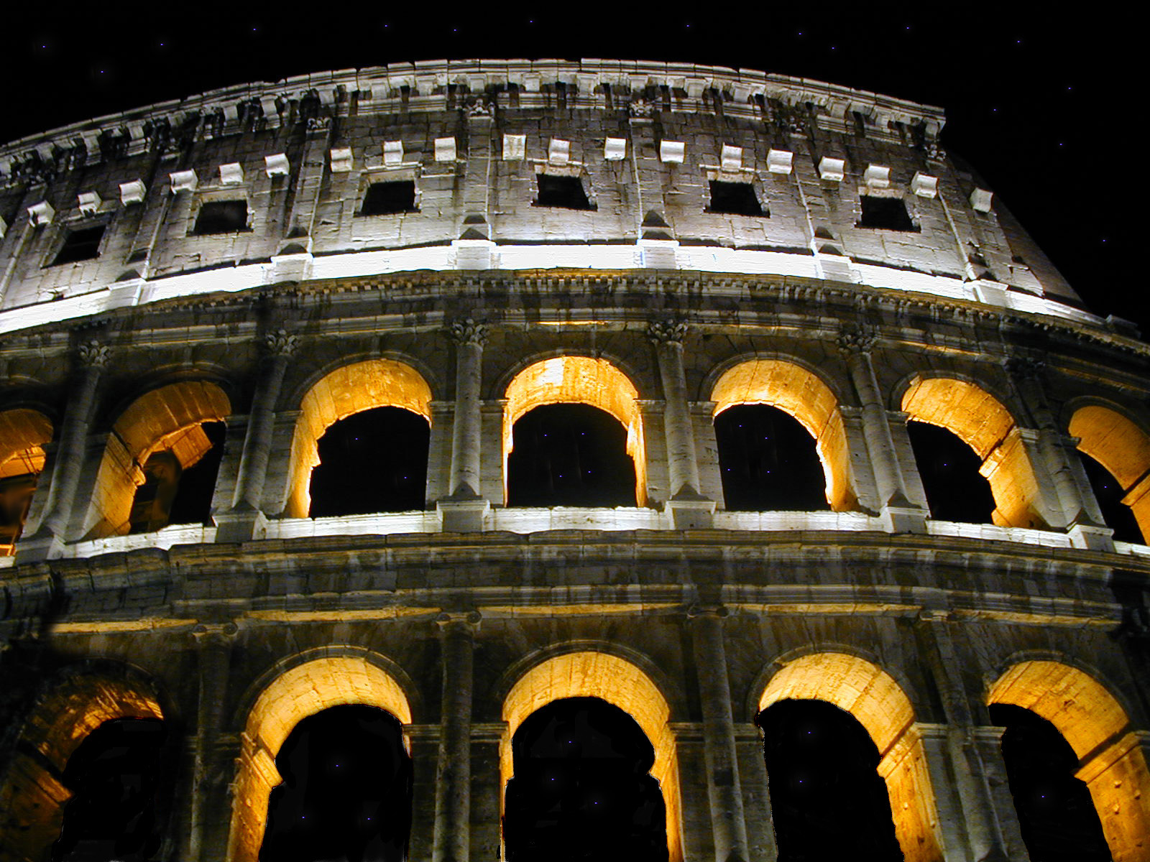
The Epistle to the
Romans
Israel: Future
Chapter 11 Cont’d

Slide 2

What About Israel?
¹ I say then, Hath God cast away his people? God forbid. For I also am an Israelite, of the seed of Abraham, of the tribe of Benjamin.
Romans 11:1
The Church began with Jews
Paul was a Jew and a Christian
‘God has not ‘cast away’ the Jews because most of the early Church is Jewish’

Slide 3
What About Israel?
Paul makes the point:
As with Elijah, God had ‘reserved’ some of Israel for Himself
So, in the early Church, many Jews had become believers and were saved and had not been ‘cast off’

Slide 4
What About Israel?
⁵ Even so then at this present time also there is a remnant according to the election of grace.
Romans 11:5
The BIG question…
What about national Israel?

Slide 5
What About Israel?
Paul restates the question:
⁷ What then? Israel hath not obtained that which he seeketh for; but the election hath obtained it, and the rest were blinded
⁸ (According as it is written, God hath given them the spirit of slumber, eyes that they should not see, and ears that they should not hear;) unto this day.
(those reserved by God)
(those reserved by God)
Romans 11:7-8
Isaiah 27:10 / 6:9

Slide 6
Permanent Blindness?
¹¹ I say then, Have they stumbled that they should fall?
God forbid: but rather through their fall salvation is come unto the Gentiles, for to provoke them to jealousy.
Romans 11:11
Is this blindness permanent?
From the context, the ‘they’ has to refer to those whose eyes have been blinded (in verse 8)
i.e. National Israel

Slide 7
Summary
Paul is addressing the issue of Israel
Many Jew’s have been saved (reserved)
(this would include the majority of the early church prior to Paul’s missionary journeys)
The rest of Israel has been blinded due to their unbelief & rejection of Christ
But the blindness is not permanent
God has allowed it that salvation may go to the Gentiles
This will provoke Israel to jealousy

Slide 8
Paul’s Summary
²⁵ For I would not, brethren, that ye should be ignorant of this mystery, lest ye should be wise in your own conceits; that blindness in part is happened to Israel, until the fulness of the Gentiles be come in.
Romans 11:25
Part of the nation has been blinded
Specifically, those that reject Yeshua as their Messiah

Slide 9
Paul’s Summary
²⁵ For I would not, brethren, that ye should be ignorant of this mystery, lest ye should be wise in your own conceits; that blindness in part is happened to Israel, until the fulness of the Gentiles be come in.
Romans 11:25
When will the fulness of the Gentiles be gathered in?
When will the last Gentile be saved?
If we can determine that, we can know when Israel’s blindness will be removed.

Slide 10
Fullness of the Gentiles
When will the fullness of the Gentiles be come in?
- Some think it will be the Rapture
However, two difficulties:
Gentiles continue ‘coming in’ (are saved) during the Tribulation
Israel’s blindness is not lifted at the time of the Rapture
In fact: We know from John 5:43 that Israel will accept ‘Antichrist’ staying in spiritual blindness – for the first three & half yrs of the Tribulation

Slide 11
Fullness of the Gentiles
If we ask:
When is the fullness of the Gentiles come in?
(When are the last Gentiles saved?)

Slide 12
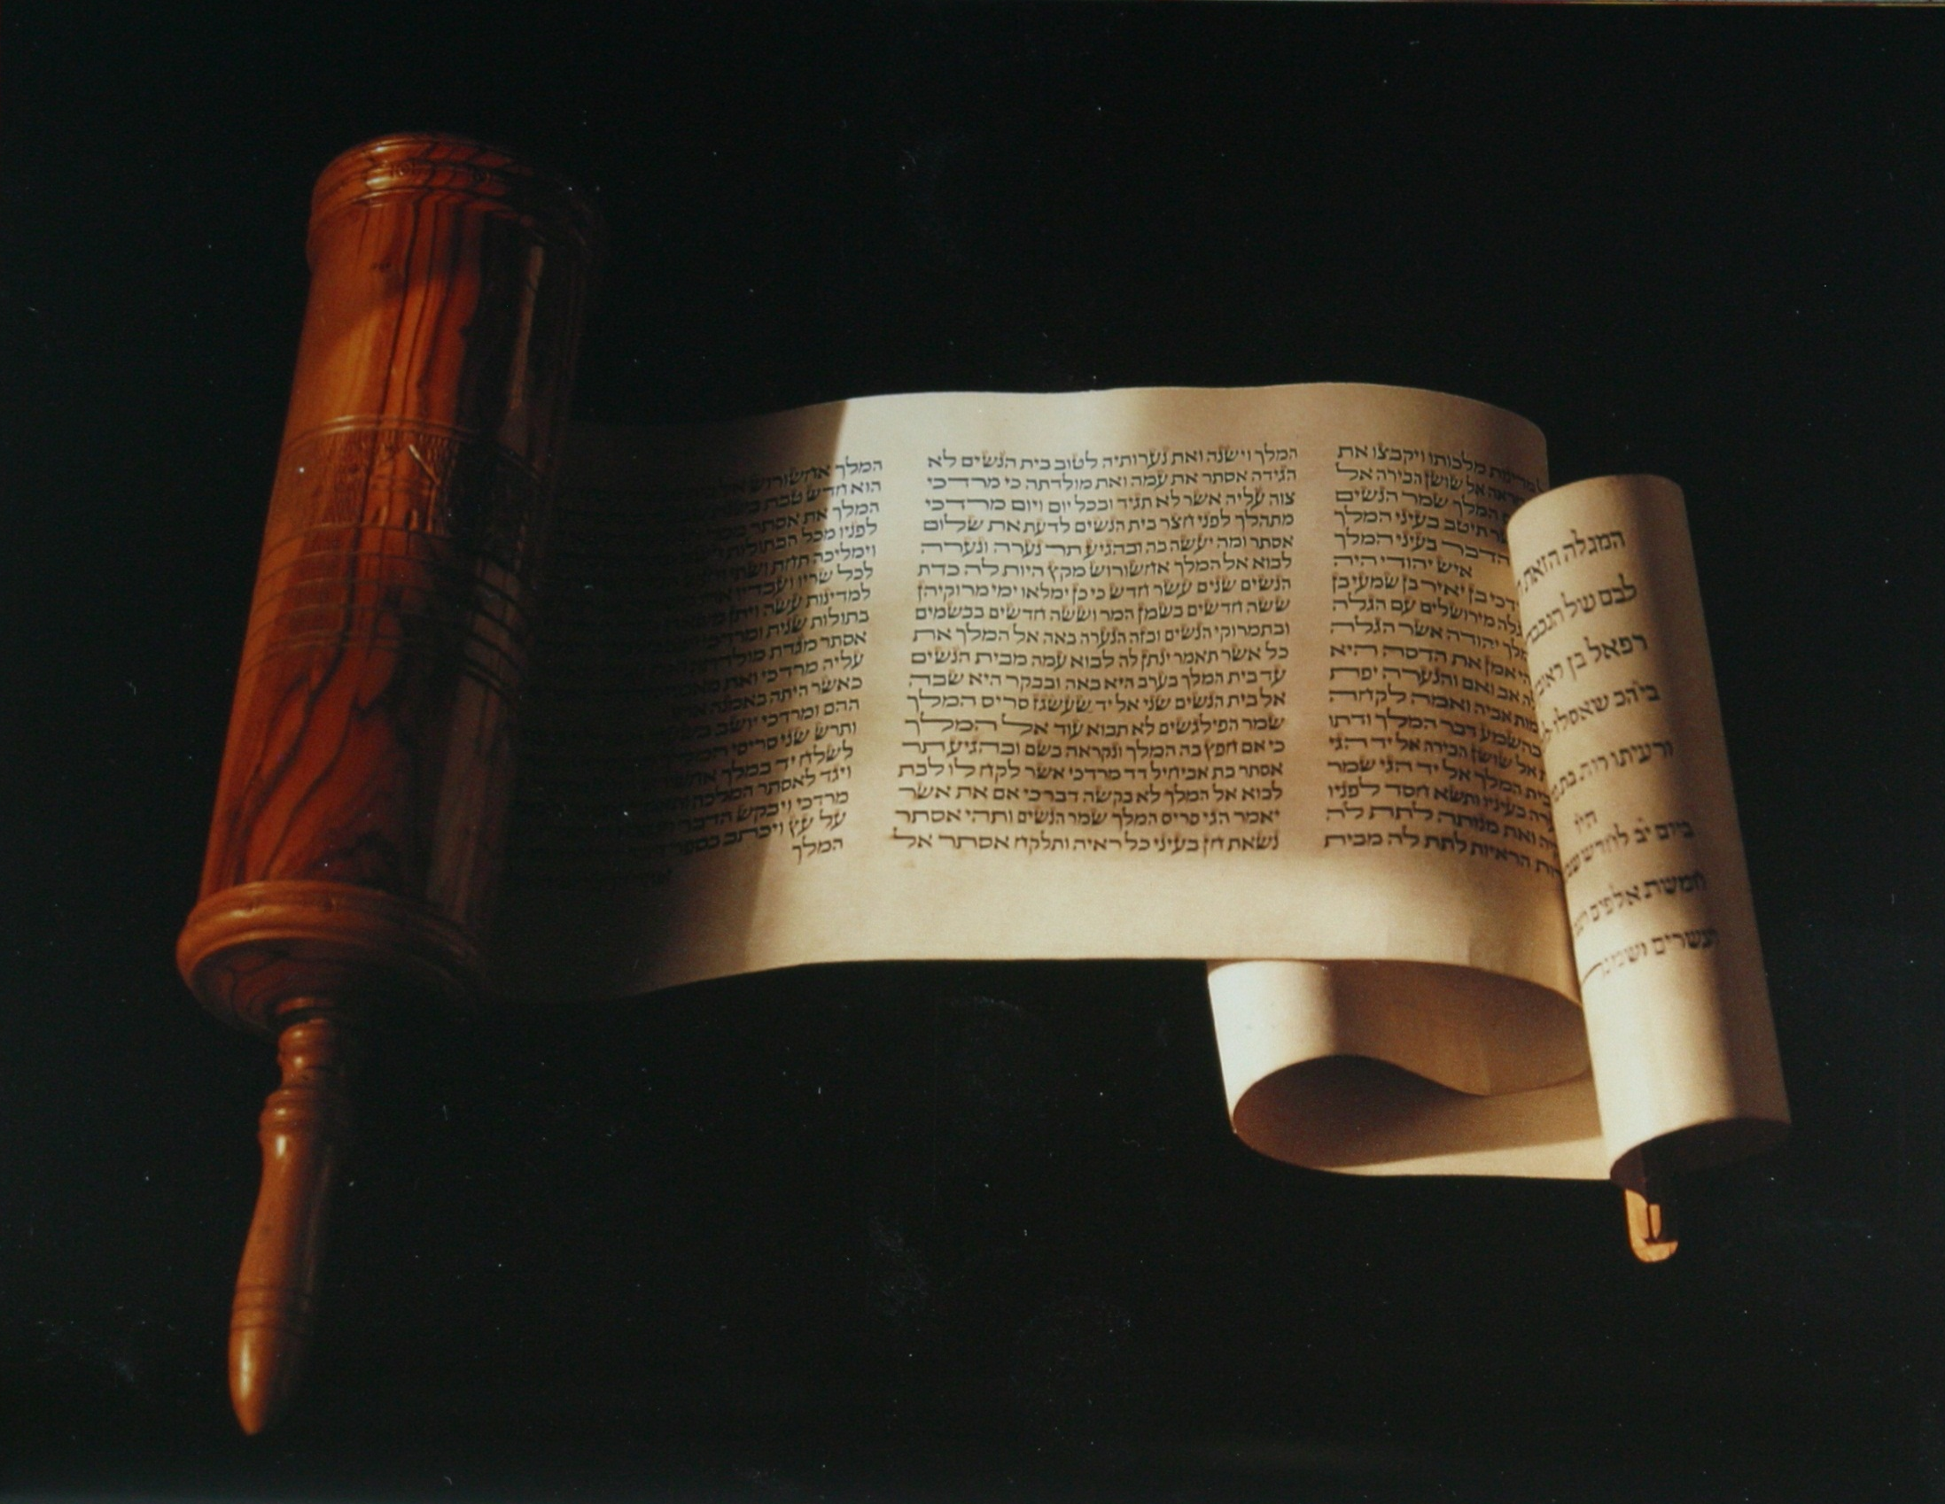
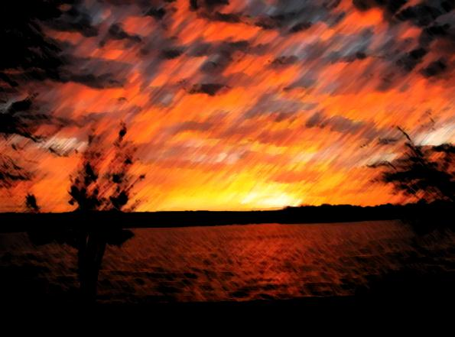

The Revelation of Jesus Christ
Chapter 15
The Great Tribulation
(& the fulness of the Gentiles)

Slide 13
¹ And I saw another sign in heaven, great and marvellous, seven angels having the seven last plagues; for in them is filled up the wrath of God.
Revelation 15:1
Great & Marvelous: The Greek words here are megas thaumastos, which literally translated could be rendered ‘exceedingly great and to be wondered at’.
We re now entering the final stage of the wrath of God being poured out on this unbelieving, wicked, Christ-rejecting world!
Notes:
John has seen a number of signs to this point, so to state that this one is ‘great and marvelous’ should grab our attention!

Slide 14
² And I saw as it were a sea of glass mingled with fire: and them that had gotten the victory over the beast, and over his image, and over his mark, and over the number of his name, stand on the sea of glass, having the harps of God.
Revelation 15:2
All those who are God’s are now removed from the Earth
There is no record of any Gentile being saved from this time forward
Thus, the fullness of the Gentiles has come in
Notes:
The Church was Raptured before the Tribulation began, prior to the start of the seven years. A great multitude was then saved and taken out of the Tribulation (as recorded in ch 7:13-14). The two witnesses were then removed when their work was complete, and in the last chapter we saw the removal of the 144,000. All this has been in preparation for the coming hour of wrath. All that remained was for these tribulation martyrs to be killed by the edict of Antichrist for refusing to receive the mark of the beast or his name. Thus, just as with Lot and the destruction of Sodom & Gomorrah, all the righteous are now removed and time for the pouring out of these vials has come.

Slide 15
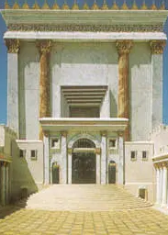
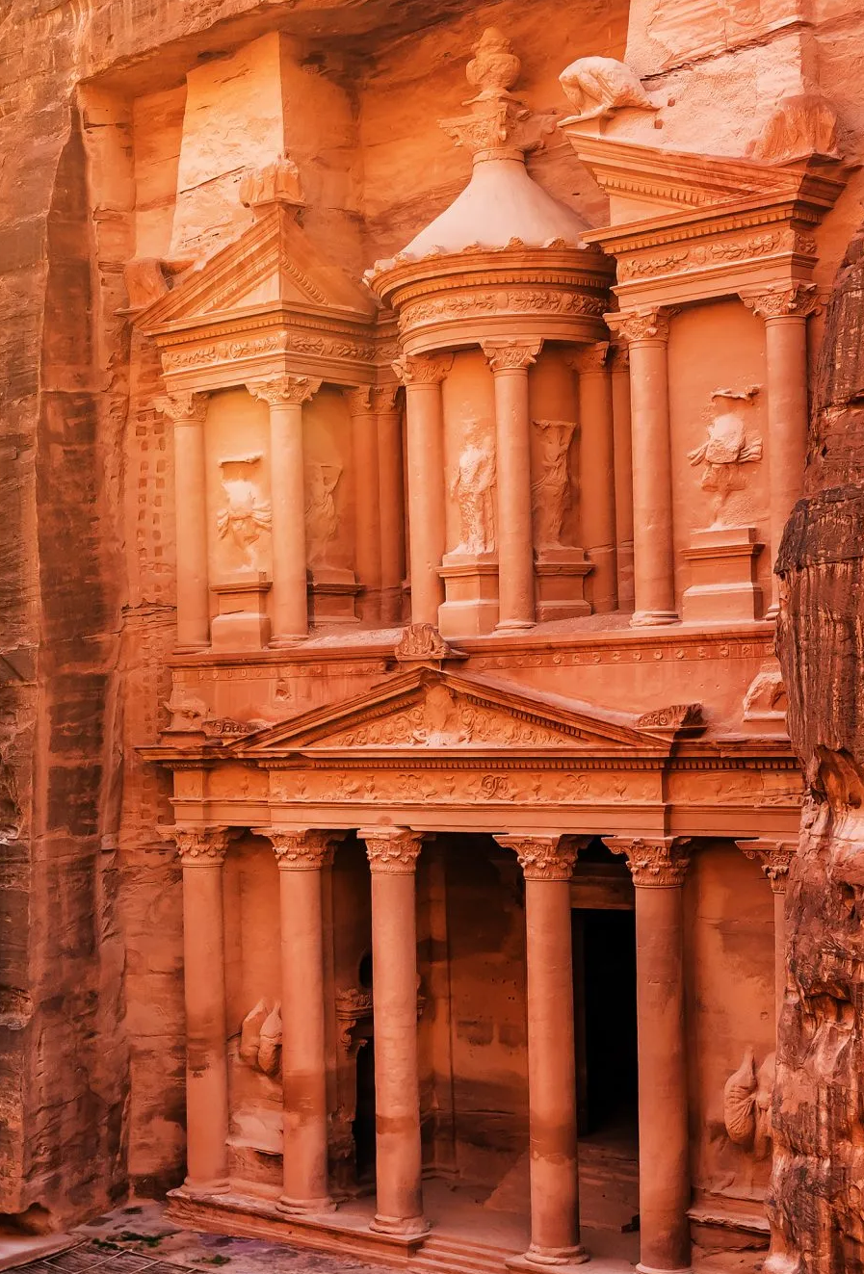
The Tribulation
Church Raptured
Second Coming
The Beginning of Sorrows
The Great Tribulation
3 ½ Years
3 ½ Years
The 7 Seals
?
6 Trumpets
(7th Trumpet)
7 Thunders
The Two Witnesses
The 144,000 Jews
7 Vials
The Tribulation Martyrs
7 Years
Notes:
See notes

Slide 16
Israel’s Sight Restored?
If we now ask:
When will Israel’s blindness be removed?

Slide 17
Israel’s Sight Restored?
¹⁵ I will go and return to my place, till they acknowledge their offence, and seek my face: in their affliction they will seek me early.
Hosea 5:15
Israel’s affliction will occur from the mid-point of the Tribulation onwards

Slide 18
The Tribulation
Church Raptured
Second Coming
The Beginning of Sorrows
The Great Tribulation
3 ½ Years
3 ½ Years
The 7 Seals
?
6 Trumpets
(7th Trumpet)
7 Thunders
The Two Witnesses
The 144,000 Jews
7 Vials
The Tribulation Martyrs
7 Years
Notes:
See notes

Slide 19
Fullness of the Gentiles
& Opening of Israel’s Eyes
Israel’s Blindness Ended
Last Gentiles Saved
Beginning of Sorrows
Great Tribulation
7yrs of Tribulation

Slide 20
Paul’s Summary
²⁵ For I would not, brethren, that ye should be ignorant of this mystery, lest ye should be wise in your own conceits; that blindness in part is happened to Israel, until the fulness of the Gentiles be come in.
²⁶ And so all Israel shall be saved..
Romans 11:25-26
All Israel?
Yes! Both believing Jews who accepted Christ (becoming the ecclesia)
AND the unbelieving/blinded Jews who eyes will now be opened

Slide 21
All Israel
God has blinded the eyes of National Israel on account of their unbelief
  But it will not be permanent
The blindness will be removed and they will be restored when the fullness of the Gentiles have been gathered in
  then all Israel will finally be saved
All =
The ‘remnant’ (who are part of the Church)
- And…
- The ‘blinded’ (who are not)

Slide 22
Paul’s Summary
²⁵ For I would not, brethren, that ye should be ignorant of this mystery, lest ye should be wise in your own conceits; that blindness in part is happened to Israel, until the fulness of the Gentiles be come in.
²⁶ And so all Israel shall be saved: as it is written, There shall come out of Sion the Deliverer, and shall turn away ungodliness from Jacob:
²⁷ For this is my covenant unto them, when I shall take away their sins.
Romans 11:25-27

Slide 23
Jeremiah 31
³¹ Behold, the days come, saith the LORD, that I will make a new covenant with the house of Israel, and with the house of Judah:
³² Not according to the covenant that I made with their fathers in the day that I took them by the hand to bring them out of the land of Egypt; which my covenant they brake, although I was an husband unto them, saith the LORD:
Jeremiah 31:31-33

Slide 24
Jeremiah 31
³³ But this shall be the covenant that I will make with the house of Israel; After those days, saith the LORD, I will put my law in their inward parts, and write it in their hearts; and will be their God, and they shall be my people.
Jeremiah 31:31-33

Slide 25
Israel or the Church?
Many believe that these promises have now been ‘transferred’ to the Church
Can these promises be transferred?
The promises were made to the House of Israel & the House of Judah
This is an issue of God’s integrity
Does He keep His promises?

Slide 26
Deuteronomy 28
⁵⁸ If thou wilt not observe to do all the words of this law that are written in this book, that thou mayest fear this glorious and fearful name, THE LORD THY GOD;
⁵⁹ Then the LORD will make thy plagues wonderful, and the plagues of thy seed, even great plagues, and of long continuance, and sore sicknesses, and of long continuance.
Deuteronomy 28:58-67
No one assumes these are transferred!

Slide 27
Deuteronomy 28
⁶⁰ Moreover he will bring upon thee all the diseases of Egypt, which thou wast afraid of; and they shall cleave unto thee.
⁶¹ Also every sickness, and every plague, which is not written in the book of this law, them will the LORD bring upon thee, until thou be destroyed.
⁶² And ye shall be left few in number, whereas ye were as the stars of heaven for multitude; because thou wouldest not obey the voice of the LORD thy God.
Deuteronomy 28:58-67

Slide 28
Deuteronomy 28
⁶³ And it shall come to pass, that as the LORD rejoiced over you to do you good, and to multiply you; so the LORD will rejoice over you to destroy you, and to bring you to nought; and ye shall be plucked from off the land whither thou goest to possess it.
⁶⁴ And the LORD shall scatter thee among all people, from the one end of the earth even unto the other; and there thou shalt serve other gods, which neither thou nor thy fathers have known, even wood and stone.
Deuteronomy 28:58-67

Slide 29
Deuteronomy 28
⁶⁵ And among these nations shalt thou find no ease, neither shall the sole of thy foot have rest: but the LORD shall give thee there a trembling heart, and failing of eyes, and sorrow of mind:
⁶⁶ And thy life shall hang in doubt before thee; and thou shalt fear day and night, and shalt have none assurance of thy life:
Deuteronomy 28:58-67

Slide 30
Deuteronomy 28
⁶⁷ In the morning thou shalt say, Would God it were even! and at even thou shalt say, Would God it were morning! for the fear of thine heart wherewith thou shalt fear, and for the sight of thine eyes which thou shalt see.
Deuteronomy 28:58-67

Slide 31
Incredible Prophecy
For failure to obey the Mosaic Law…
Israel would be driven from the Land of Israel
Israel would be scattered among all people
‘From one end of earth to the other’
Their lives would hang in doubt
They would be in great distress
All this has happened! (to the letter!)
Yet Israel remains as an identifiable ethnic group
Contrast with Hittites / Jebusites / Amalakites

Slide 32
Deuteronomy 30
¹ And it shall come to pass, when all these things are come upon thee, the blessing and the curse, which I have set before thee, and thou shalt call them to mind among all the nations, whither the LORD thy God hath driven thee,
² And shalt return unto the LORD thy God, and shalt obey his voice according to all that I command thee this day, thou and thy children, with all thine heart, and with all thy soul;
Deuteronomy 30:1-6

Slide 33
Deuteronomy 30
³ That then the LORD thy God will turn thy captivity, and have compassion upon thee, and will return and gather thee from all the nations, whither the LORD thy God hath scattered thee.
⁴ If any of thine be driven out unto the outmost parts of heaven, from thence will the LORD thy God gather thee, and from thence will he fetch thee:
Deuteronomy 30:1-6

Slide 34
Deuteronomy 30
⁵ And the LORD thy God will bring thee into the land which thy fathers possessed, and thou shalt possess it; and he will do thee good, and multiply thee above thy fathers.
⁶ And the LORD thy God will circumcise thine heart, and the heart of thy seed, to love the LORD thy God with all thine heart, and with all thy soul, that thou mayest live.
Deuteronomy 30:1-6

Slide 35

T H E
MYSTERY OF
R E T E R N

Slide 36
THE MYSTERY OF RETURN
The Jubilean ordinance in Leviticus 25 there is a specific Hebrew word that in itself sums up the Jubilee Mystery..
It is the command “tashuvu” ‘you shall return’
It comes from the Hebrew root word “shuv”
  ‘Shuv’ is filled with meaning.
  It can be translated as 'to return, to turn back, to recover, to reverse, to recur, to relinquish, to receive back, to restore, and to come home.'
All those things describe what happened in the Jubilean years.

Slide 37
THE MYSTERY OF RETURN
Yet there's a deeper dimension to the word and to the mystery.
According to the ancient covenant, if the people of Israel remained joined to God, they would remain joined to the land.
But if they departed from God, they would depart from the land.
The physical realm was bound to the spiritual.
Physical separation from the land would be a manifestation of a spiritual separation from God.

Slide 38
THE MYSTERY OF RETURN
Shuv also means "To repent."
To repent is to return and to come home and to be restored.
According to the Law and the Prophets, if the nation turned away from God, the people would be taken into exile and scattered to the ends of the earth.
And it happened exactly as it was prophesied.

Slide 39
THE MYSTERY OF RETURN
Before a physical departure of such magnitude could have taken place, there had to have been a spiritual departure.
But the Scriptures also prophesy that at the end of the age, the Jewish people will return not only physically to the land…
…but spiritually to God
From the beginning Israel was called to be a light to the nations, to give the world the word of God, to teach the world the ways of God, to bring forth the Messiah

Slide 40
THE MYSTERY OF RETURN
Yet Israel rejected their Messiah and national blindness was pronounced upon them…
.. Which has lasted almost 2000 years.
Before Israel could return to the land, before that could begin, there had to be a Spiritual return – its the Jubilee principle
In the nineteenth century a spiritual revival took place among the Jewish people.
And it was a return to that from which they had departed two thousand years earlier

Slide 41
THE MYSTERY OF RETURN
A return to their Messiah, Yeshua.
It was only after the spiritual return began that the physical return to the land was set in motion.
The two returns were joined together, just as had been the two departures.
Each return represented the reclaiming of a lost possession, the physical return to Israel's physical possession, and the spiritual return to the nation's spiritual possession

Slide 42
THE MYSTERY OF RETURN
Where did the spiritual return take place?
According to the prophecy, it would take place among the nations where the Lord had driven them.
It would begin in Europe, in the British Empire.
The same empire that would later play a central role in the Jewish people’s physical return would first play a central role in their spiritual return.
And both returns would center on the same city.

Slide 43
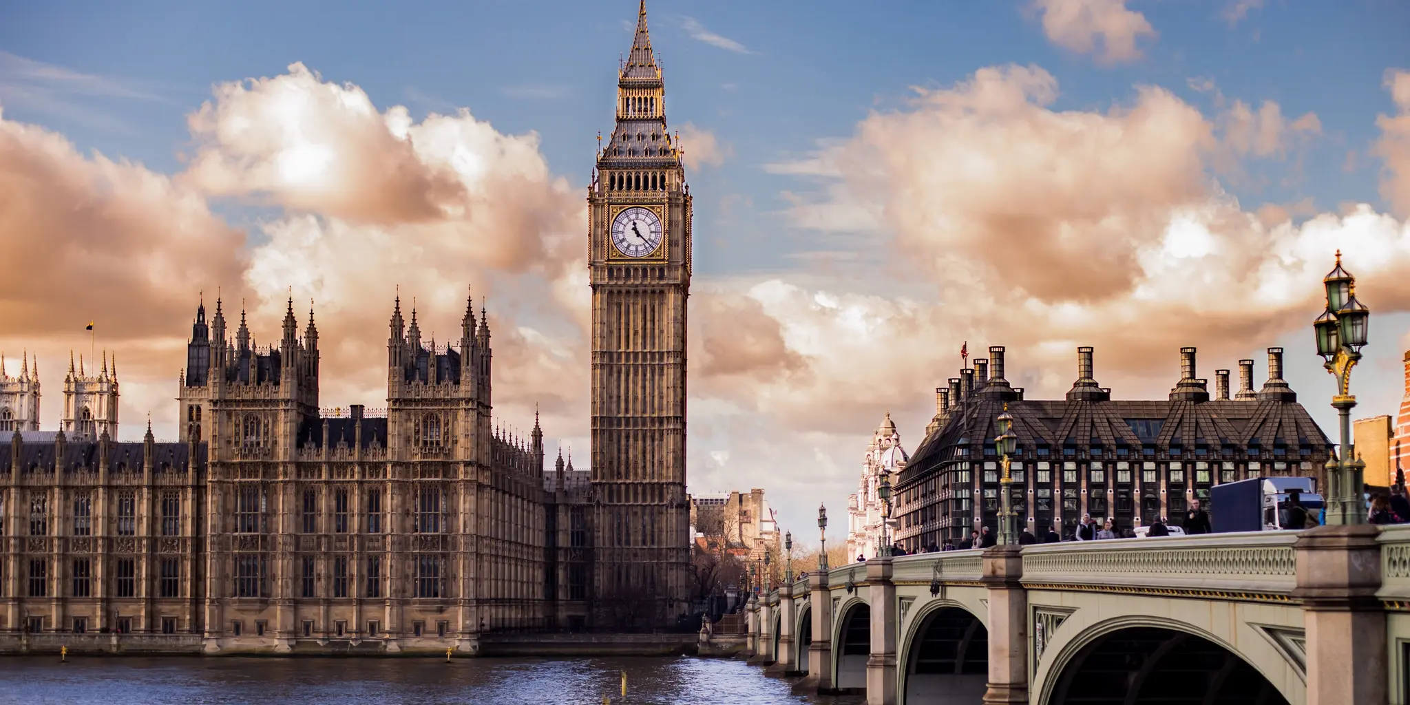
LONDON

Slide 44
THE MYSTERY OF RETURN
In the first century, in the days of the Book of Acts, a gathering took place of Messianic Jewish believers, disciples, apostles, and leaders in Jerusalem.
It was from that gathering that the door of faith would be opened to the nations.
The gospel would go forth beyond the land of Israel to the nations.
And the Gentiles would now come in.

Slide 45
THE MYSTERY OF RETURN
That gathering would change the course of world history.
But as the first century neared its end and the days of the Book of Acts drew to a close, such gatherings of Jewish believers disappeared from the world.
But in the days of return that which disappeared must reappear!

Slide 46
THE MYSTERY OF RETURN
So was there another gathering, the first such gathering in two thousand years, the first such council of Messianic Jewish believers since the days of the disciples!
They came from the nations, teachers, leaders, and emissaries, to the city of London.
There they worshipped, prayed, shared, declared their identity, agreed on their purpose and mission, and arrived at a resolution.

Slide 47
THE MYSTERY OF RETURN
The gathering established the first known alliance of Messianic Jewish believers since the first disciples gathered in Jerusalem two thousand years earlier.
One of the speakers at the event reminded the assembly of its ancient origins. He said this:
  “There was a meeting a long time ago, when Jews from every nation were gathered together, and the Lord poured out His Spirit upon them: that was the first Hebrew- Christian Alliance”
Notes:
Abraham Cappadose - Quote

Slide 48
THE MYSTERY OF RETURN
The timing of the gathering was significant
It took place in the year ... 1867
It's the reason why everything began in 1867.
It was that gathering in London that constitutes the first Jubilean event, the first return.
  That gathering convened in the spring, in the month of May - the same month in which the destruction of Israel began, when the Roman armies invaded the land
So in the same month that the destruction began, so did the restoration.

Slide 49
THE MYSTERY OF RETURN
Less than thirty days after that gathering a ship set sail from New York, bound for the Promised Land,
…and the journey of the Stranger began!
Two days later, after two thousand years, the release of the Promised Land began as the Ottoman Land Code became law.
Less than five months later, after being hidden for fifteen hundred years, the ancient city of Jerusalem was uncovered!

Slide 50
THE MYSTERY OF RETURN
And then would come the first school to teach Jewish people to farm the land
... and then the first settlement
... and then the return of the exiles.
The month of the gathering in London was May
The date?
The 14th May - the same date Israel would be reborn!

Slide 51
Partially Fulfilled
As of 1948 Israel are back in the Land
This was the first ‘regathering’
And it continues today
However…
Israel are not yet serving God with all their heart and soul

Slide 52
The Epistle to the
Romans
To be continued…

